Slide 1

Document ID
Version: 1.0
Standard Operating Procedure for P2P Process
Date of creation: 2024 April 03
Farzana
PARTICULARS
Scope
Responsibilities
Procedure
Flowchart

Slide 2
Purpose
The purpose of this SOP is to establish standardized procedures to ensure consistency, efficiency, and compliance in the Procure to Pay (P2P) process. It aims to streamline workflows, minimize errors, and maintain transparency throughout the procurement and payment lifecycle.
Scope
This SOP applies to all departments and individuals involved in the procurement and payment processes within the organization. It encompasses activities from requisition initiation to payment authorization and supplier relationship management.

Slide 3
Responsibilities
Approvers
Responsible for reviewing and approving requisitions and purchase orders within their designated authority.
Procurement Team
Responsible for initiating requisitions, selecting suppliers, and negotiating terms.
.
Finance Team
Responsible for verifying invoices, authorizing payments, and maintaining financial records.
Requisitioners
Responsible for accurately documenting procurement needs and obtaining necessary approvals.
.
Supplier Relationship Managers
Responsible for fostering positive relationships with suppliers and addressing any issues or disputes.
Accounts Payable Staff
Responsible for verifying invoices against purchase orders and processing payments.
4

Slide 4



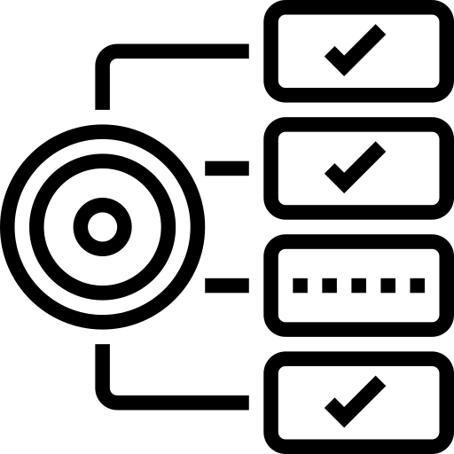
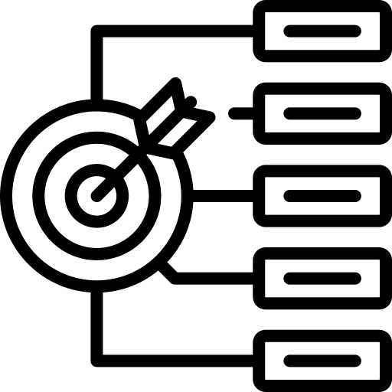
Requirements
Access to procurement related information.
Defined approval hierarchies for requisitions and purchase orders
Documentation templates for purchase orders, invoices, and receipts.
Communication channels for internal and external stakeholders.
Training resources for P2P process participants.

Slide 5
Procedure for P2P Process
Information | Input Gathering
Purpose of the SOP: Clearly state the purpose of the SOP. This could be to ensure consistency, efficiency, and compliance in the P2P process.
Scope and Applicability: Define the scope of the SOP, specifying which departments or individuals it applies to. This helps avoid confusion about responsibilities
Information | Input Gathering
1
Finalization & Implementation
6
2
Process Analysis & Mapping
5
3
Gap Analysis & best practices
Review & Feedback
4
Drafting the SOP

Slide 6
2. Process Analysis & Mapping
Roles and Responsibilities
Define Roles: Clearly outline the roles involved in the P2P process, such as requisitioners, approvers, buyers, receivers, and accounts payable staff.
Responsibilities: Specify the responsibilities associated with each role. For example, requisitioners are responsible for accurate and complete requisitions, while approvers ensure that requests comply with policies.
Requisition Process
Initiation: Detail how requisitions are initiated. This might involve a user filling out a requisition form or using a procurement software.
Approval Workflow: Describe the workflow for obtaining approvals, including who is responsible for approvals at each level.
Documentation: Specify the required documentation for creating a purchase requisition. This could include item descriptions, quantities, and any relevant specifications.
Purchase Order (PO) Creation
Generating POs: Explain the process for creating purchase orders based on approved requisitions.
Information in POs: List the essential information that must be included in a PO, such as item details, quantities, prices, and terms.
Approval Process: Define the approval process for purchase orders, including any thresholds for different levels of approval.
Supplier Selection and Negotiation
Criteria for Selection: Outline the criteria used to select suppliers, such as cost, quality, and reliability.
Negotiation Procedures: Describe how negotiations with suppliers are conducted, covering aspects like pricing, delivery schedules, and payment terms.
Documentation: Specify the documentation required to record negotiated terms and agreements.

Slide 7
3. Gap Analysis and Best Practices
Goods/Services Receipt
Acknowledging Receipt: Explain how the receiving department acknowledges the receipt of goods or services.
Inspection Procedures: If applicable, detail the procedures for physically inspecting goods to ensure they meet specifications.
Documentation: Clarify the documentation requirements for confirming the receipt of goods or services.
Invoice Verification
Verifying Invoices: Describe the process for verifying supplier invoices against corresponding purchase orders.
Handling Discrepancies: Provide procedures for handling discrepancies and resolving issues between the PO, goods receipt, and invoice.
Documentation: Specify the documentation requirements for the verification process.
Three-Way Match
Explanation: Provide a more detailed explanation of the three-way match process, emphasizing the importance of reconciling the PO, goods receipt, and invoice.
Discrepancy Resolution: Detail the steps for resolving discrepancies found during the three-way match.
Documentation: Highlight the documentation needed to support the three-way match.
Invoice Approval
Approval Workflow: Define the workflow for approving supplier invoices, specifying who is responsible for approvals.
Criteria for Approval: Outline the criteria for approving invoices, ensuring compliance with established policies.
Documentation: Clarify the documentation requirements for invoice approval.
7

Slide 8
4. Drafting the SOP
Payment Authorization
Authorization Process: Explain the process for authorizing payments after invoices have been approved.
Adherence to Payment Terms: Emphasize the importance of adhering to negotiated payment terms and any legal or contractual obligations.
Documentation: Specify the documentation requirements for authorizing payments.
Payment Execution
Processing Payments: Detail the procedures for processing payments, including the chosen payment methods (e.g., checks, electronic funds transfer).
Record-Keeping: Outline how records of completed payments are kept and maintained.
Communication with Suppliers: Describe the communication process with suppliers regarding payment status.
Record Keeping
Requirements: Clearly state the requirements for maintaining records related to P2P transactions.
Duration of Record Retention: Specify how long records should be retained and the procedures for secure storage and disposal.
Accessibility: Define who has access to these records and under what circumstances.
Supplier Relationship Management
Communication Guidelines: Provide guidelines for ongoing communication with suppliers to foster positive relationships.
Issue Resolution: Detail processes for addressing supplier issues and disputes.
Continuous Improvement: Encourage ongoing evaluation and improvement of supplier

Slide 9
5. Review and Feedback
Training and Communication
Training Programs: Outline any training programs for individuals involved in the P2P process.
Communication Channels: Specify the channels for communicating updates and changes to the P2P SOP.
Compliance and Auditing
Compliance Measures: Detail measures in place to ensure compliance with relevant policies, regulations, and legal requirements.
Audit Procedures: Outline procedures for internal and external audits of the P2P process, including frequency and reporting.
6. Finalization and Implementation
Revision History
Record of Changes: Maintain a clear record of changes made to the SOP, including dates and reasons for revisions.
References
Citations: Include references to relevant policies, regulations, or external guidelines that the SOP is based on.
7

Slide 10
General Instructions
Follow the defined procedures outlined in this SOP for each stage of the P2P process.
Ensure accurate and complete documentation at every step to maintain transparency and compliance.
Adhere to established approval hierarchies and authorization processes to prevent unauthorized transactions.
Communicate effectively with internal stakeholders and suppliers to facilitate smooth transaction processes.
Regularly review and update this SOP to reflect changes in policies, regulations, or organizational needs.
8

Slide 11
General Challenges
Resistance to change from stakeholders accustomed to existing processes.
Complexity in managing multiple suppliers and negotiating terms.
Inconsistent communication leading to delays or errors in the P2P process.
Difficulty in enforcing compliance with SOP guidelines across departments.
Potential for errors in documentation and data entry impacting financial accuracy.
8

Slide 12
Process Implementation Checklist
Do’s | Don’ts
Do follow the defined procedures outlined in this SOP to ensure consistency and compliance. | Don't bypass established approval processes outlined in this SOP.
Do maintain accurate documentation at every step to provide a clear audit trail | Don't overlook the importance of accurate documentation in maintaining financial transparency.
Do regularly review and update the SOP to reflect changes in policies or organizational needs. | Don't ignore feedback from stakeholders regarding potential improvements to the P2P process
Do prioritize transparency and accountability throughout the P2P process | Don't neglect communication with suppliers, as it can impact the timely fulfillment of orders.
8

Slide 13
Inputs

Slide 14
Link to Sample

Slide 15
Revision History
Appendix
Archives

Slide 16
THANKYOU

